Slide 1
C The Programming Language LOOPS
Lecture 10th 12th oct

Slide 2
Repetition/Loop Control
Perform a set of instructions repeatedly
Repetition continues
Counter Controlled(known, definite)
Condition Controlled (Condition true/false)
Types
While statement
For statement
Do-while statement

Slide 3
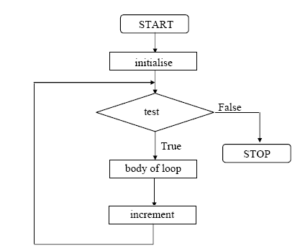
While Repetition Structure
Action repeated while some condition remains true.

Slide 4
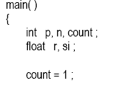
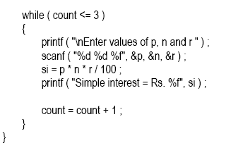
Example: (calculation of simple interest of 3 sets of p,n,and r.)

Slide 5
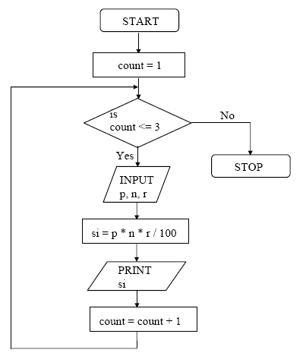

Slide 6
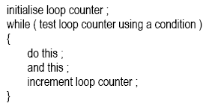
General form of While Loop:

Slide 7

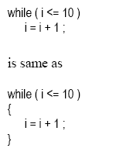
Tips and Traps:
Condition may be any valid expression:
Statements within body may be a single line or block of statements.

Slide 8
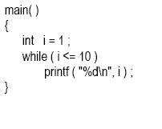
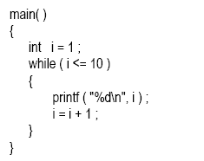
Avoid infinite loops.
The correct form is:

Slide 9
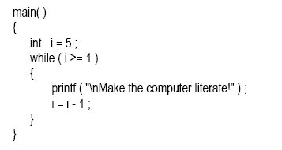
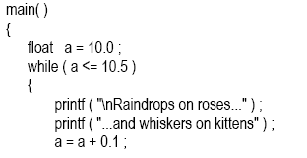

The loop counter can be both incremented or decremented.
Float can also be used as loop counter.

Slide 10
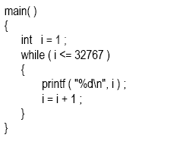
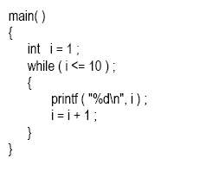
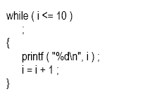
Guess the output:
Again Guess…

Slide 11
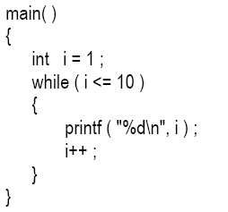
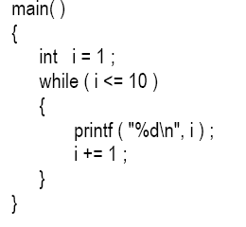
Opertaors:
Increment operator
Pre-Increment: ++i
Post-Increment: i++
Decrement operator
Pre-Decrement: --i
Post-Decrement: i--
Compound assignment operator
i+=1;
i*=2;

Slide 12
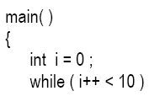

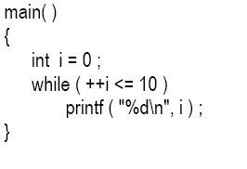
Examples:

Slide 13
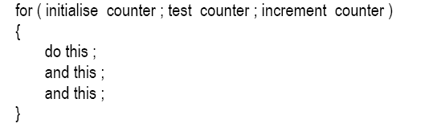
The For Loop:
Most Popular
For Loop requires:
Name of control variable/Loop counter
Initial value of control variable
Condition to test for final value.
Increment/Decrement to modify control variable when looping.
General form of For Loop is:

Slide 14
Example:
main ()
{
int i;
for(i=0;i<=10;i++)
printf(“%d”,i);
}

Slide 15
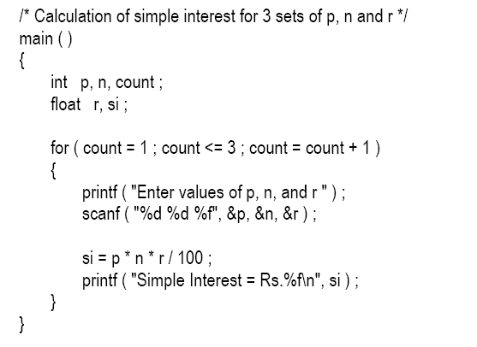
Example 2:

Slide 16
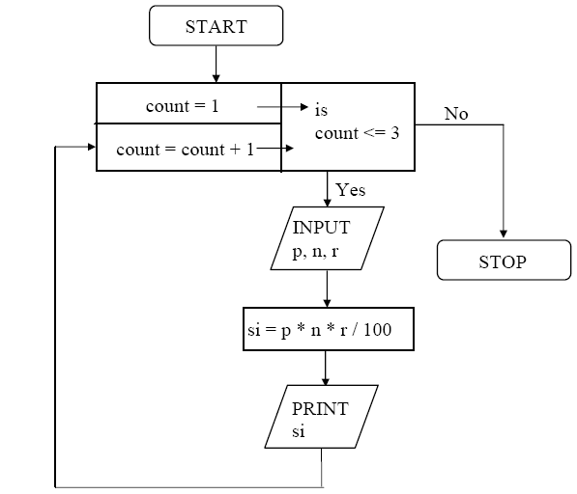

Slide 17
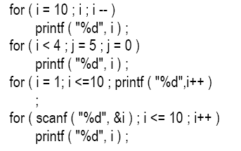
Certain variations:

Slide 18
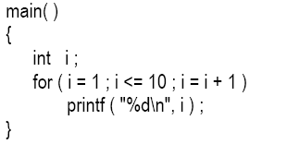
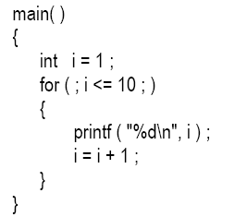
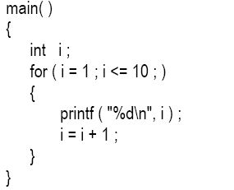
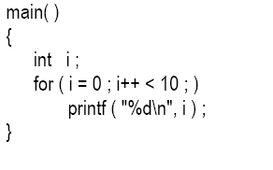
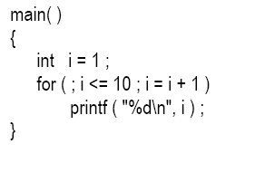
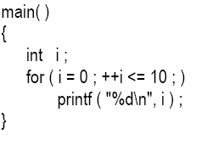
1)
4)
2)
5)
3)
6)

Slide 19
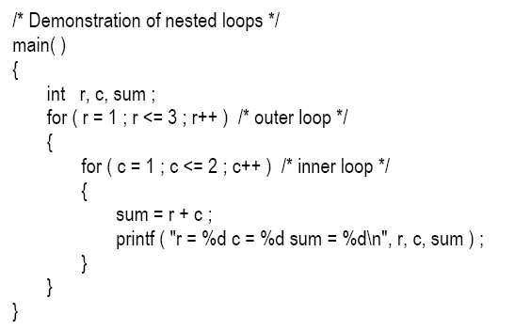
Nesting of For loop:

Slide 20
Multiple Initializations in the for Loop
for ( i = 1, j = 2 ; j <= 10 ; j++ )
Multiple statements can also be used in the incrementation expression of for loop.
Only one expression is allowed in the test expression.
This expression may contain several conditions linked together using logical operators.

Slide 21
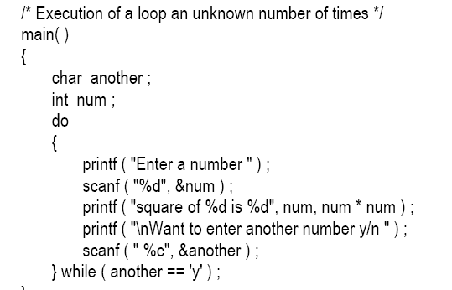
The ODD loop:

Slide 22
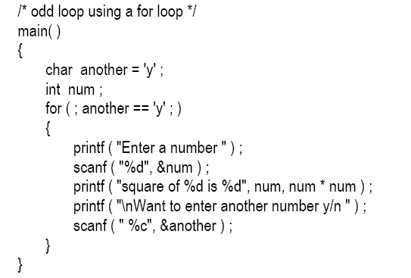
Cont’d:

Slide 23
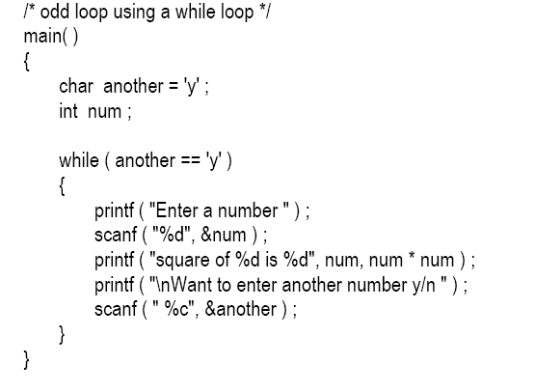
Cont’d:

Slide 24
The Break Statement:
When break is encountered inside any loop, control automatically passes to the first statement after the loop. A break is usually associated with an if.
Example: Write a program to determine whether a number is prime or not. A prime number is one, which is divisible only by 1 or itself.

Slide 25
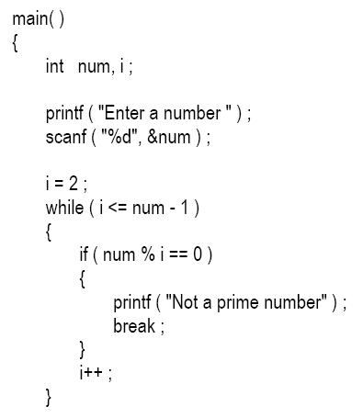
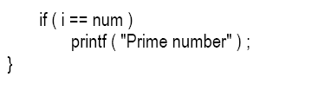

Slide 26

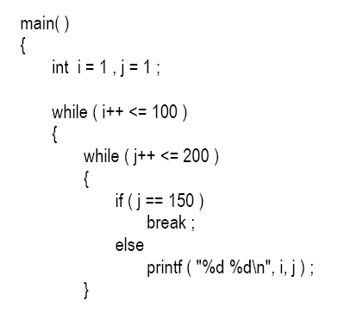

Example 2:

Slide 27
The continue Statement
Sometimes we want to take the control to the beginning of the loop, bypassing the statements inside the loop, which have not yet been executed.
The keyword continue allows us to do this.
When continue is encountered inside any loop, control automatically passes to the beginning of the loop.

Slide 28
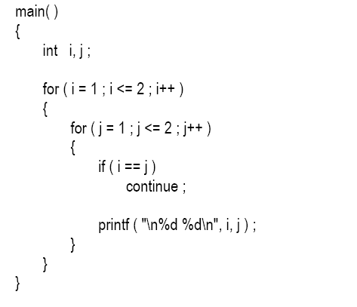
Example:

Slide 29
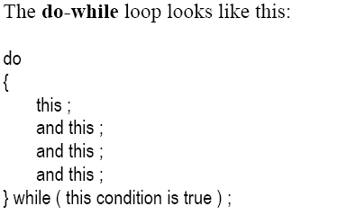
Do-While Loop:

Slide 30
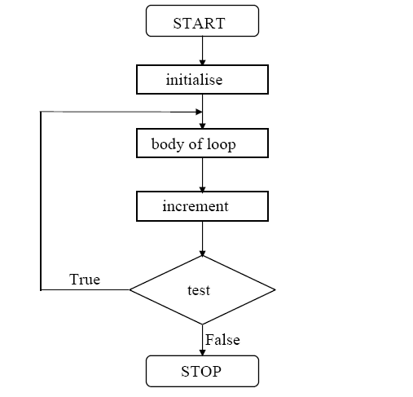

Slide 31
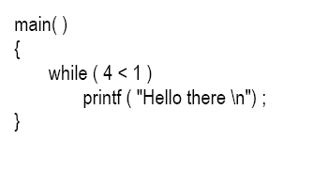
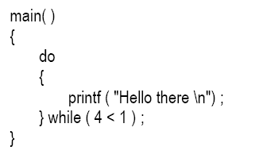
Comparison of While and Do-While:

Slide 32
End…..

